Slide 1

OPERATING SYSTEM
ADITYA COLLEGE OF ENGINEERING &
TECHNOLOGY
(Multi-Threading programming)
(Unit-2)

Slide 2
Contents
Aditya College of Engineering &
Technology
Multi-Threading Programming
Why do we need scheduling?
When does scheduling happen?
What is CPU Scheduling?
Types of CPU Scheduling?
Types of Schedulers
Scheduling Queues
Scheduling Criteria
Objectives of process scheduling algorithms

Slide 3
Multithreading
Aditya College of Engineering &
Technology
What are Threads?
Thread is an execution unit which consists of its own program counter, a stack, and a set of registers.
Threads are also known as Lightweight processes.
Threads are popular way to improve application through parallelism.
The CPU switches rapidly back and forth among the threads giving illusion that the threads are running in parallel.
As each thread has its own independent resource for process execution, multiple processes can be executed parallel by increasing number of threads.

Slide 4
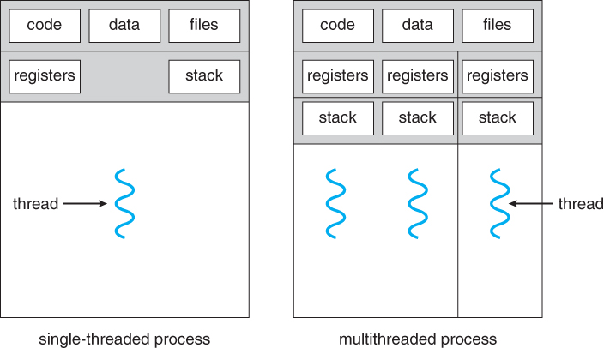
Thread
Aditya College of Engineering &
Technology

Slide 5
Difference between Process and Thread
Aditya College of Engineering &
Technology
S.N. | Process | Thread
1 | Process is heavy weight or resource intensive. | Thread is light weight, taking lesser resources than a process.
2 | Process switching needs interaction with operating system. | Thread switching does not need to interact with operating system.
3 | In multiple processing environments, each process executes the same code but has its own memory and file resources. | All threads can share same set of open files, child processes.
4 | If one process is blocked, then no other process can execute until the first process is unblocked. | While one thread is blocked and waiting, a second thread in the same task can run.
5 | Multiple processes without using threads use more resources. | Multiple threaded processes use fewer resources.
6 | In multiple processes each process operates independently of the others. | One thread can read, write or change another thread's data.

Slide 6
Types of Threads
Aditya College of Engineering &
Technology
There are two types of threads:
User Threads
Kernel Threads
User threads, are above the kernel and without kernel support. These are the threads that application programmers use in their programs.
Kernel threads are supported within the kernel of the OS itself.
All modern OSs support kernel level threads, allowing the kernel to perform multiple simultaneous tasks and/or to service multiple kernel system calls simultaneously.

Slide 7
Multithreading Models
Aditya College of Engineering &
Technology
The user threads must be mapped to kernel threads, by one of the following strategies:
Many to One Model
One to One Model
Many to Many Model

Slide 8
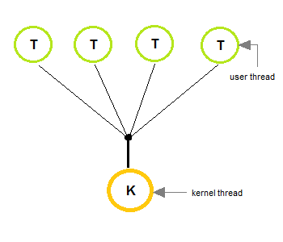
Many to One Model
Aditya College of Engineering &
Technology
In the many to one model, many user-level threads are all mapped onto a single kernel thread.
Thread management is handled by the thread library in user space, which is efficient in nature.
Ex: Solaris os

Slide 9
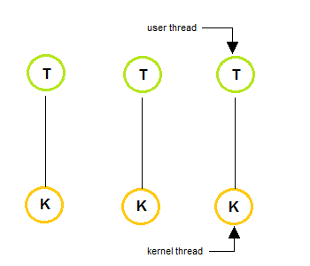
One to One Model
Aditya College of Engineering &
Technology
The one to one model creates a separate kernel thread to handle each and every user thread.
Most implementations of this model place a limit on how many threads can be created.
Linux and Windows from 95 to XP implement the one-to-one model for threads.

Slide 10
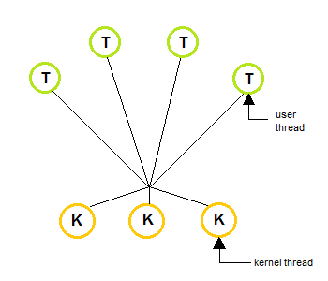
Many to Many Model
Aditya College of Engineering &
Technology
The many to many model multiplexes any number of user threads onto an equal or smaller number of kernel threads, combining the best features of the one-to-one and many-to-one models.
Users can create any number of the threads.
Blocking the kernel system calls does not block the entire process.
Processes can be split across multiple processors.

Slide 11
Benefits of multi-threading
Aditya College of Engineering &
Technology
Low Context Switch Overhead
High Computation Speed up
No Need of IPC
Decreased Response time
Sharing of Resources

Slide 12
Inter-Process Communication
Aditya College of Engineering &
Technology
A process can be of two types:
Independent process.
Co-operating process.
An independent process is not affected by the execution of other processes while a co-operating process can be affected by other executing processes.
Inter process communication (IPC) is a mechanism which allows processes to communicate with each other and synchronize their actions.
The communication between these processes can be seen as a method of co-operation between them.
Processes can communicate with each other through both:
Shared Memory
Message passing

Slide 13
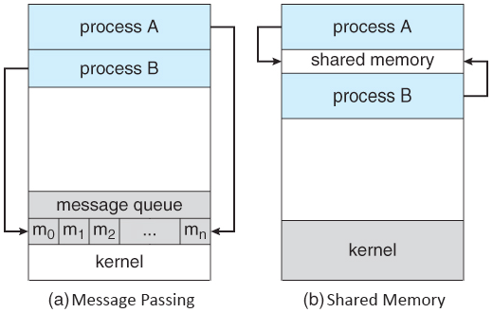
Aditya College of Engineering &
Technology

Slide 14
Aditya College of Engineering &
Technology
THANK YOU

